Slide 1
Example System – Tumor Growth
System
Tumor
Model
p(t) is the tumor volume in mm³
q(t) is the carrying capacity of the endothelial cells in mm³,
α ,B,d,G are constants.
u(t) is the angiogenic dose (input)
dp^{2/3}q models endogenous inhibition of the tumor, 2/3 exponent represents the conversion of the tumor volume into a tumor surface area

Slide 2
Example System – Tumor Growth
Control

Slide 3
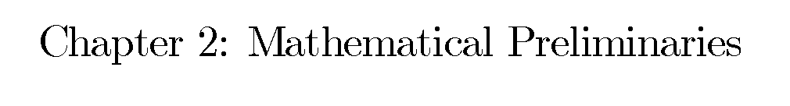
Overall goal is to develop tools to show that a differential equation has a solution, i.e. we are working towards Theorem 2 in this chapter.
Note: We are not saying that we can find this solution.
The errata for the book is on the class website (tinyurl.com/ece874)

Slide 4
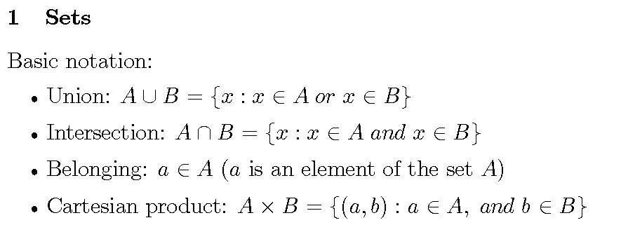
The set of all x such that x is an element of set A or x is an element of set B (or both)
such that
The set of all pairs (a,b) such that a is an element of set A and b is an element of set B

Slide 5
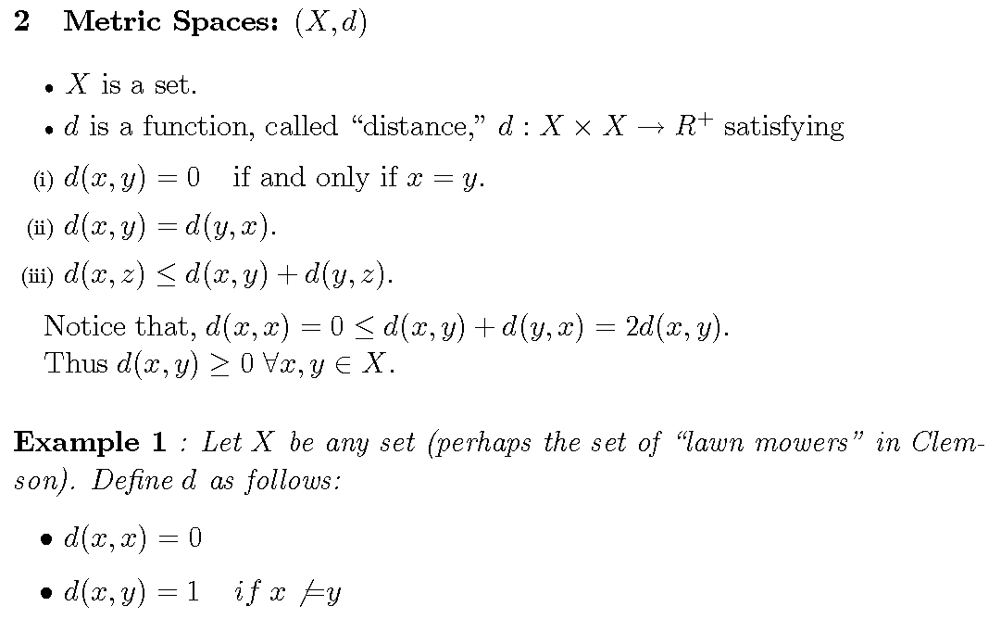
d is a function that assigns each ordered pair (x,y), where x∈ X and y∈X, to a unique element d(x,y) ∈[0,∞)
Triangle inequality

Slide 6
? Is the d above a “distance” ?




Slide 7
Normed Vector Spaces (Vector space, distance measure)
Vector is a geometric entity with length and direction.
Starts at 0
Norm is the length of the vector

Slide 8
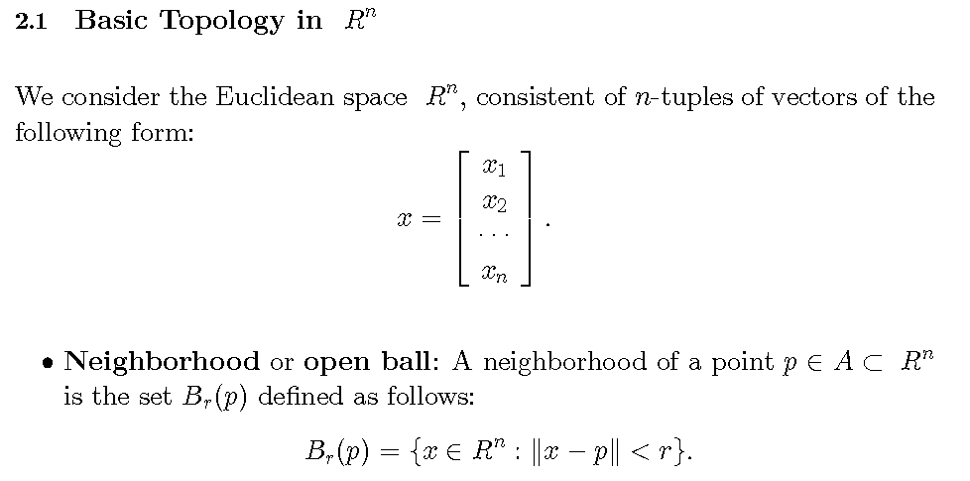

Slide 9
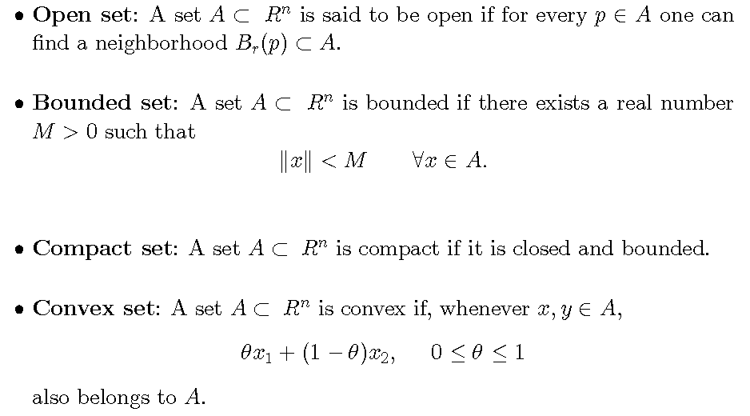
Typically the Euclidian-norm for control discussions
Not Open
Needed in adaptive control

Slide 10
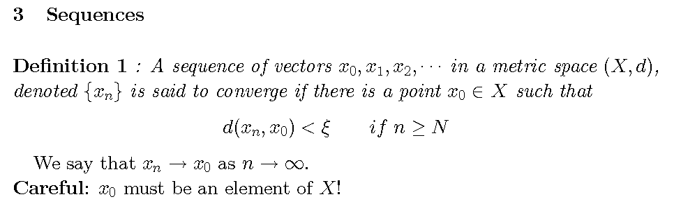
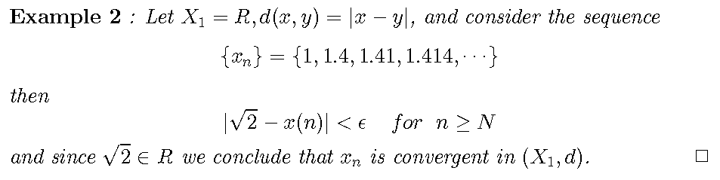
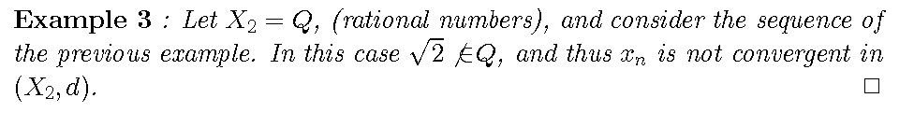

Slide 11
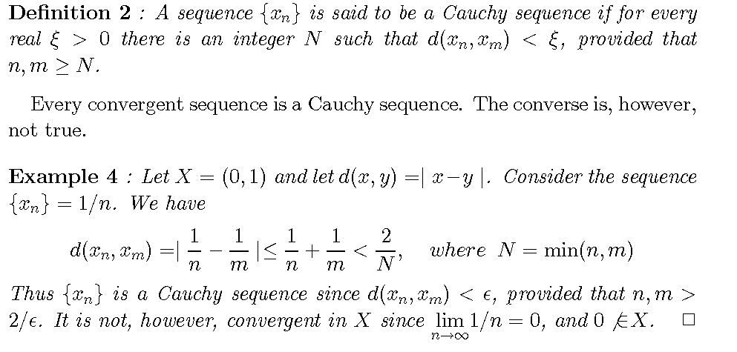

(
)

Slide 12
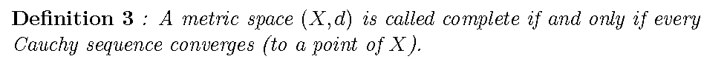

Slide 13
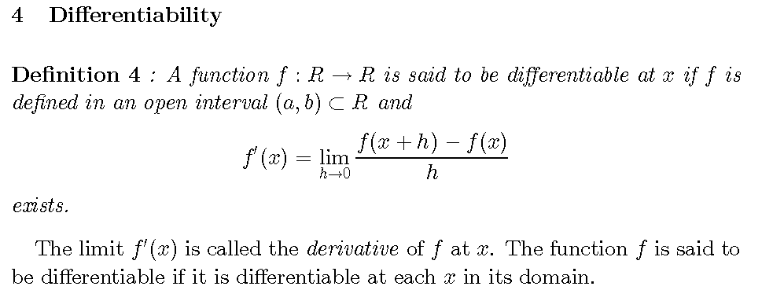

Slide 14
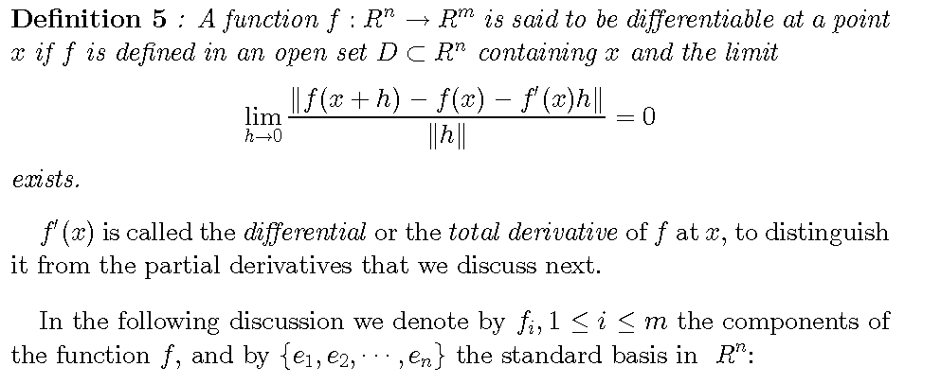

Slide 15
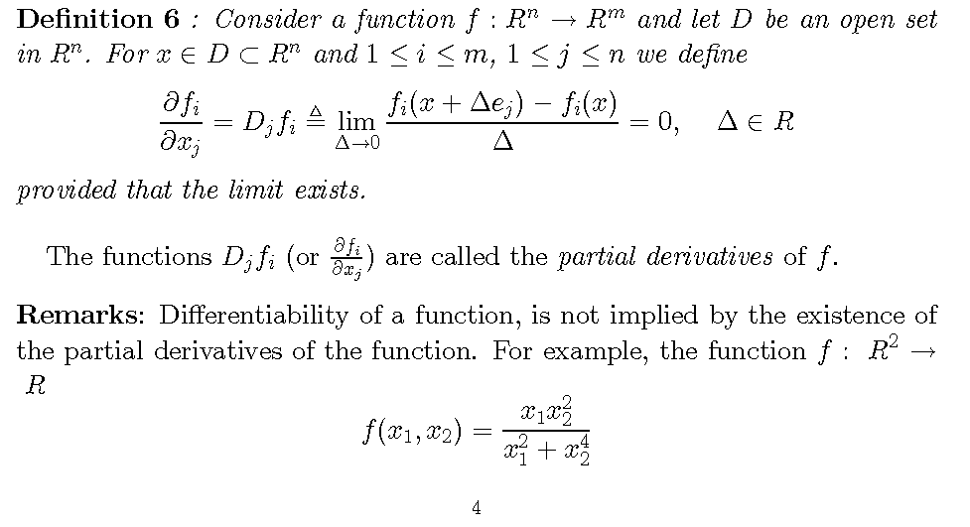
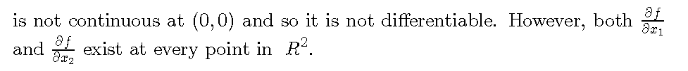

Slide 16
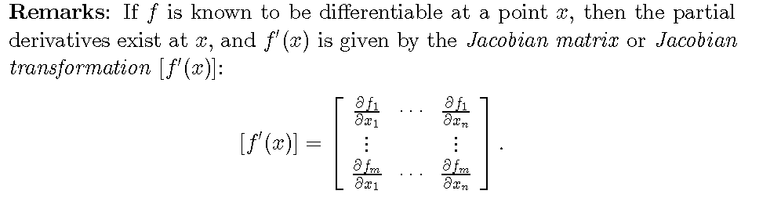
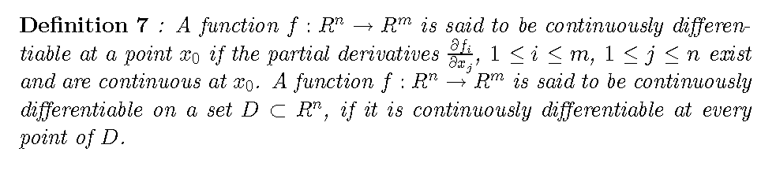

Slide 17
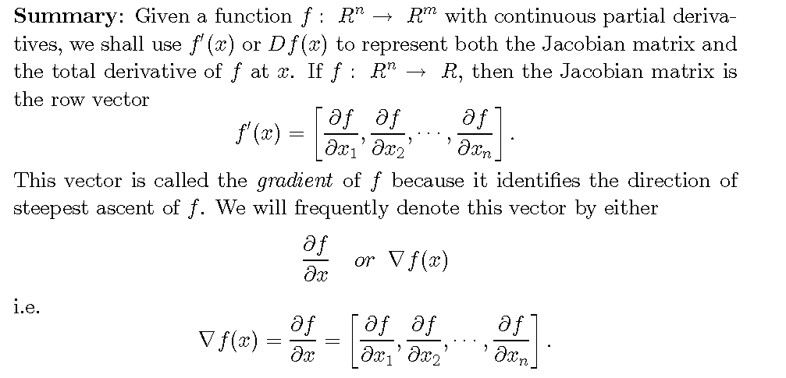

Slide 18
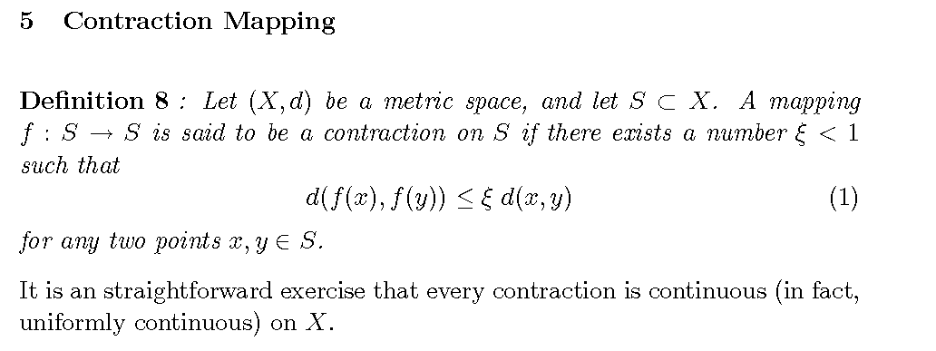
Will be used to analyze the existence and uniqueness of solutions to some nonlinear differential equations

f()
1
Need only one ξ for any x,y, i.e. doesn’t have to hold for every ξ less than 1.

[
)
[
)
[
]
0
1
S

Slide 19
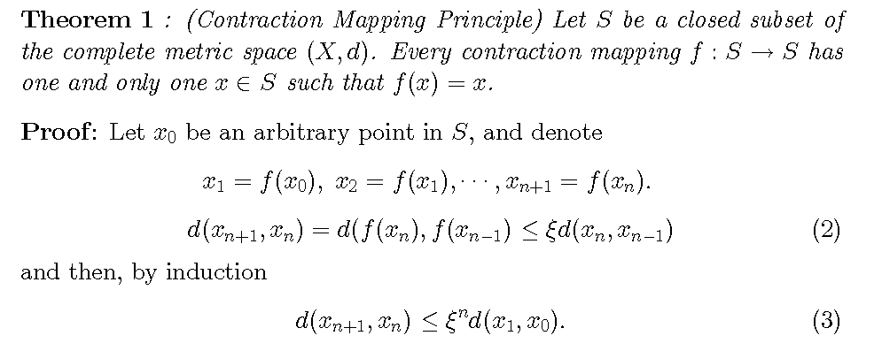
Fixed point

Slide 20
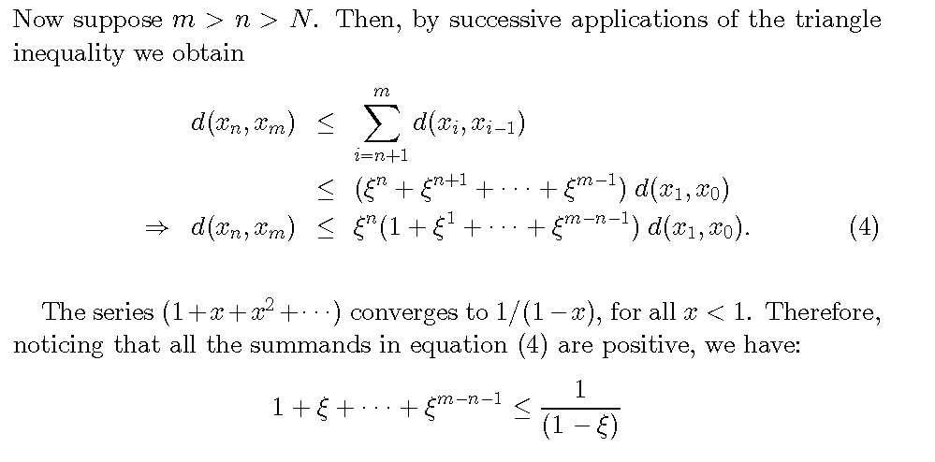

Slide 21
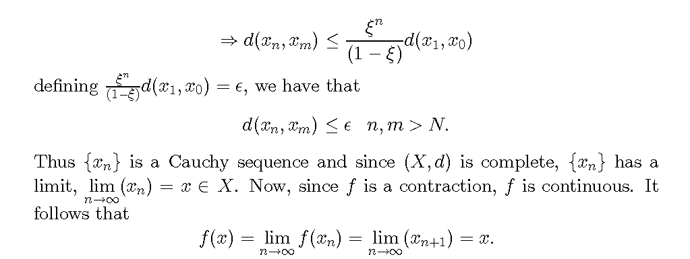

Slide 22
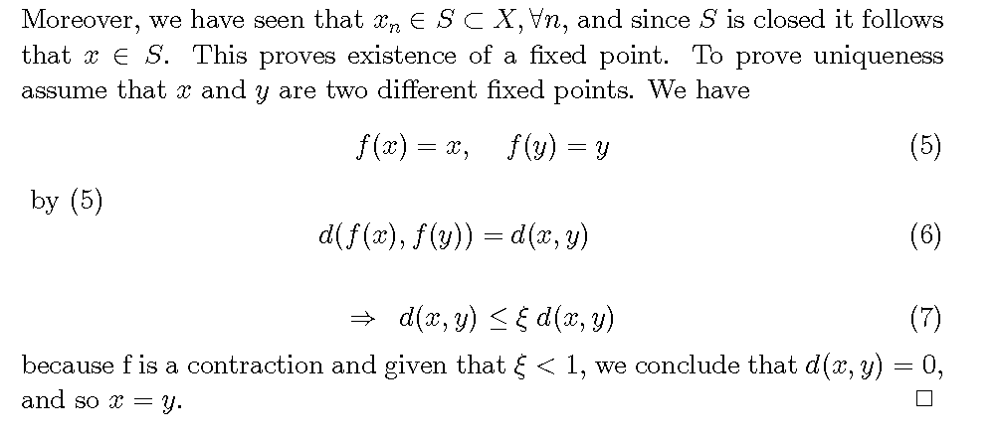

Slide 23
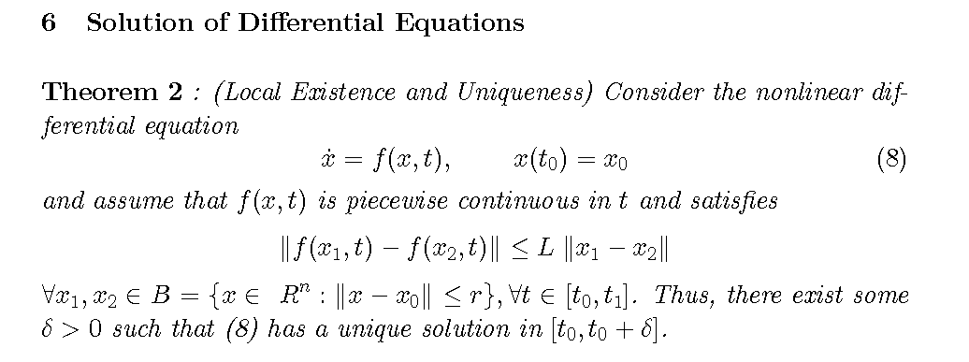

Slide 24
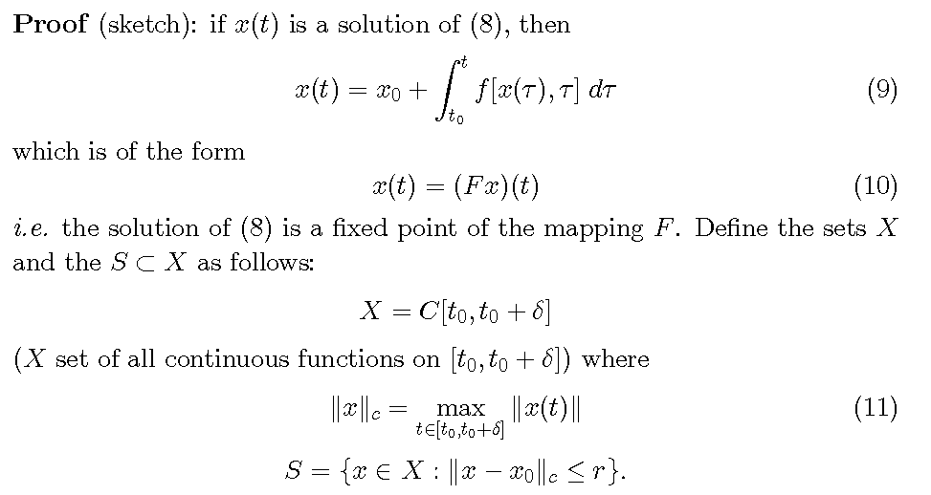

Slide 25
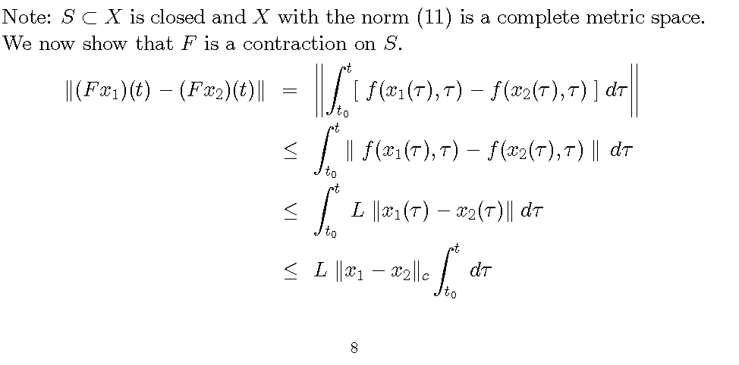
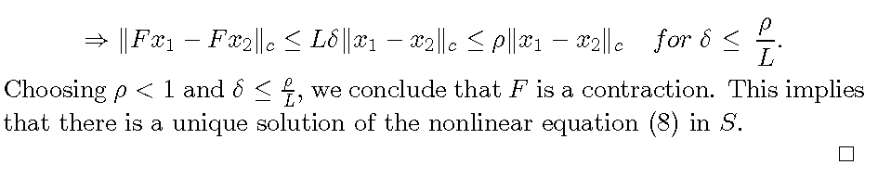

Slide 26
Extend the local theorem
Global

Slide 27
Chapter 2 Conclusions
Can talk about the solutions of a differential equation without actually solving.
  This will be the basis for the rest of the class

Slide 28
Homework 2
A. Chapter 2 - Problems 2.8, 2.13
B. Analyze the Tumor Growth Model:
For u=0
  Find the equilibrium points
  Plot phase portrait for u=0 (plot -2 to 20000 on both axes)
For u= .09 (constant dose)
  Find the equilibrium points
  Plot phase portrait for u=0 (plot -2 to 20000 on both axes)
For u=kq with k=10 (linear, proportional control)
  Find the equilibrium points
  Plot phase portrait for u=0 (plot -2 to 20000 on both axes)
  What happens for other values of k?

Slide 29

Homework 2
C. Introduction to Simulink
Go to Controls Tutorial at:
http://ctms.engin.umich.edu/CTMS/index.php?aux=Home
Follow the instructions to use Simulink (not MATLAB) to simulate motor speed and motor position models. Record model file and output plots.

Slide 30
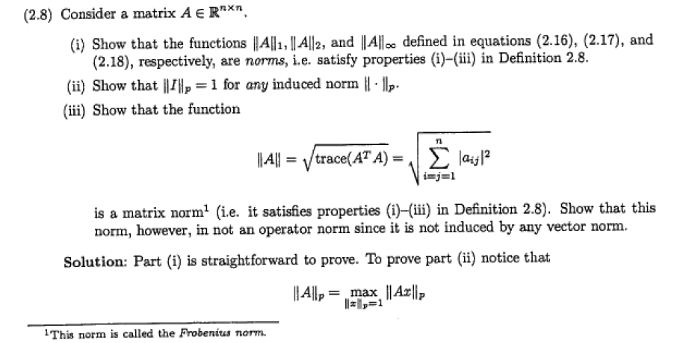
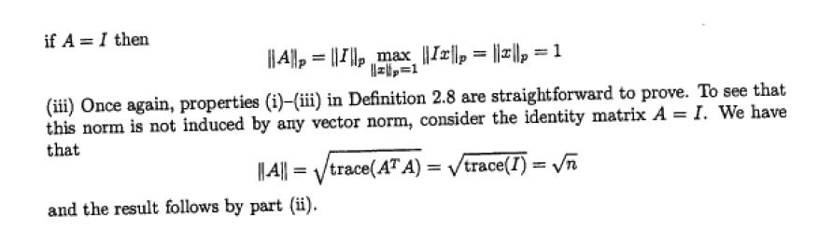
Homework – Solution

Slide 31
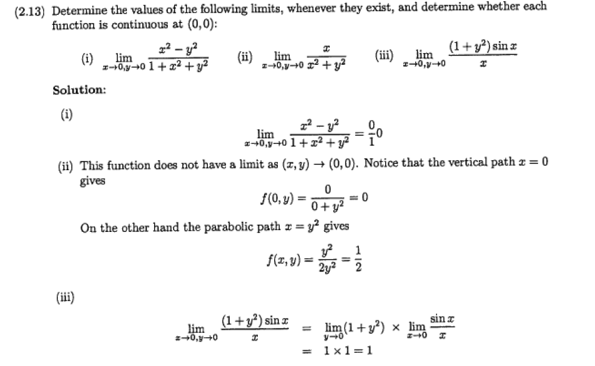
Homework – Solution

Slide 32
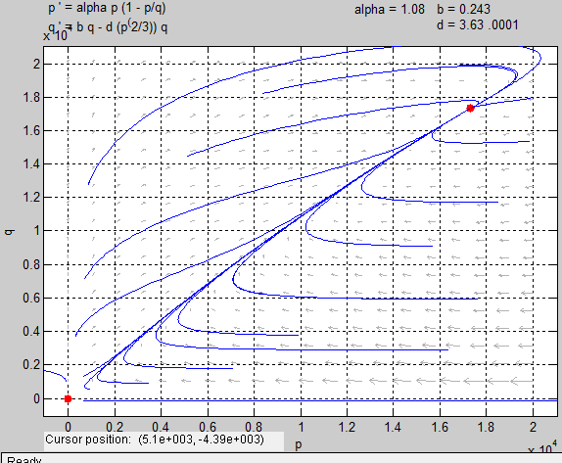
Homework – Solution
.
u=0
p₀ = q₀ =0
p₀ = q₀ = 17320 mm³
Tumor will reach a maximum size

Slide 33
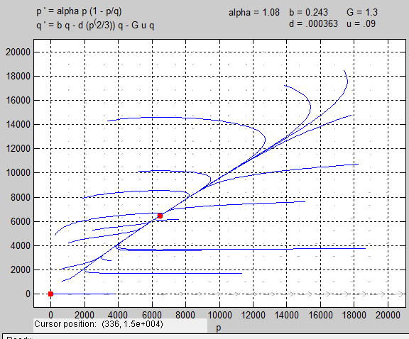
Homework – Solution
u= .09
p₀ = q₀ =0
p₀ = q₀ = 6,466 mm³
Tumor will shrink but not disappear.
If therapy is stopped, tumor will grow to the original equilibrium size.

Slide 34
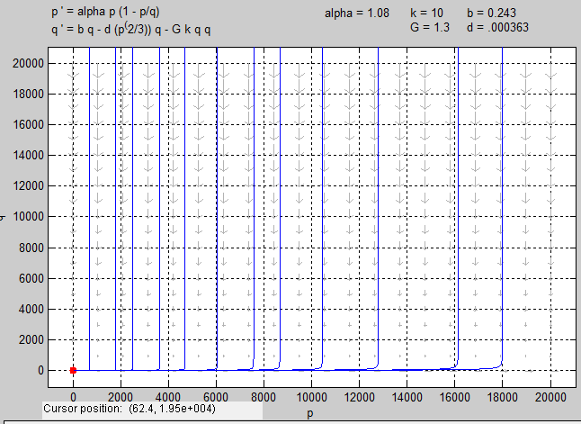
Homework – Solution
For u=kq with k=10 (linear, proportional control)
Linear control appears to work well.
Result is somewhat misleading because we assumed that the tumor had grown to a certain size before the angiogenic model becomes valid (can’t really show it goes to zero).

